Slide 1
Things I Like
Harold Treen

Slide 2
Relationship Accountability

Slide 3
Relationship Accountability
Stable Ambiguity: Fear of being alone + unwillingness to invest fully.
Relationship Accountability: Breaking patterns that lead to ambiguity/resentment.

Slide 4
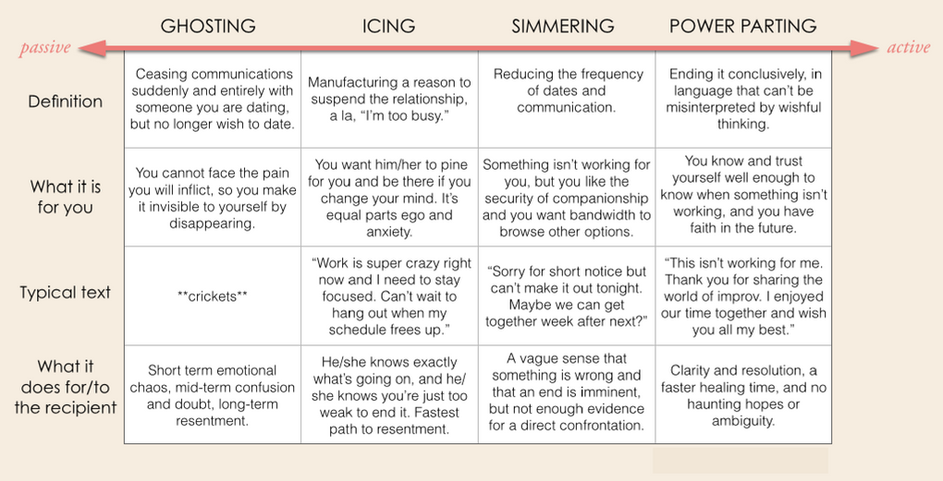
Relationship Accountability

Slide 5
Invitations

Slide 6
Invitations
Two ways to communicate an interest in spending time with others.
Questions:
Requires an immediate response.
Awkward to say no - can lead to feelings of obligation.
Eg. “Would you like to go to a movie saturday?”
Invitations
Provides information - receiver not required to respond.
Plans based around things you would be doing anyway.
Eg. “I’m going to the movies Saturday. It would be great to have you along!”

Slide 7
Non-Violent Communication

Slide 8
Non-violent Communication
Reframing conflict as an expression of unmet needs.
Cultivating awareness of our own feelings/needs.
Expressing needs in a way that inspires compassion.

Slide 9
Polarizing Spaces

Slide 10
Polarizing Spaces
Non-Polarizing Spaces:
General spaces that don’t cater to a specific set of values/interests.
Examples:
Starbucks, Bars, Parks
Polarizing Spaces:
Spaces that cater to a specific set of values/interest.
Examples:
Improv classes (acting/performing/comedy)
Couchsurfing (travel, cost-saving, meeting new people)
Recurse Center (self-direction, coding, self-improvement)

Slide 11
Essentialism

Slide 12
Essentialism
Only accepting “Hell Yes!” opportunities
YAGNI - “You aren’t going to need it”
Learning through experience.
The value of news?

Slide 13
Etc...

